Slide 1
Bird Strike
Himanshu Verma 202118029
Jenil Doshi 202118034
Harsh Doshi 202118038
Siraj Shaikh 202118041

Slide 2
Aim of Project
Yearly Analysis
Top Airlines in terms of having encountered most Bird Strikes
Airports with Most Bird Strikes
Top 10 Bird Species affecting Bird Strikes
Average Cost incurred yearly due to Bird Strikes
Phase of the Flight at the Time of the Strike
Impact of Flight
Prior Warning and Effect: Impact of Flight Relation
Worst hit conditions for Bird strike (yearly)

Slide 3
Dataset Description
We have 26 columns and 25559 rows and some of the rows are:
Airport Name
Aircraft: Airline/Operator
Effect: Impact to Flight (None, Precautionary Landing, Aborted Take-off, Other, Engine Shut Down)
When: Phase of the Flight (Approach, Landing Roll, Take-off Run, Climb, Descent, Taxi, Parked)
Conditions: Sky(No Cloud, Some Cloud, Overcast)
Wildlife Species (Different Types of Birds)

Slide 4
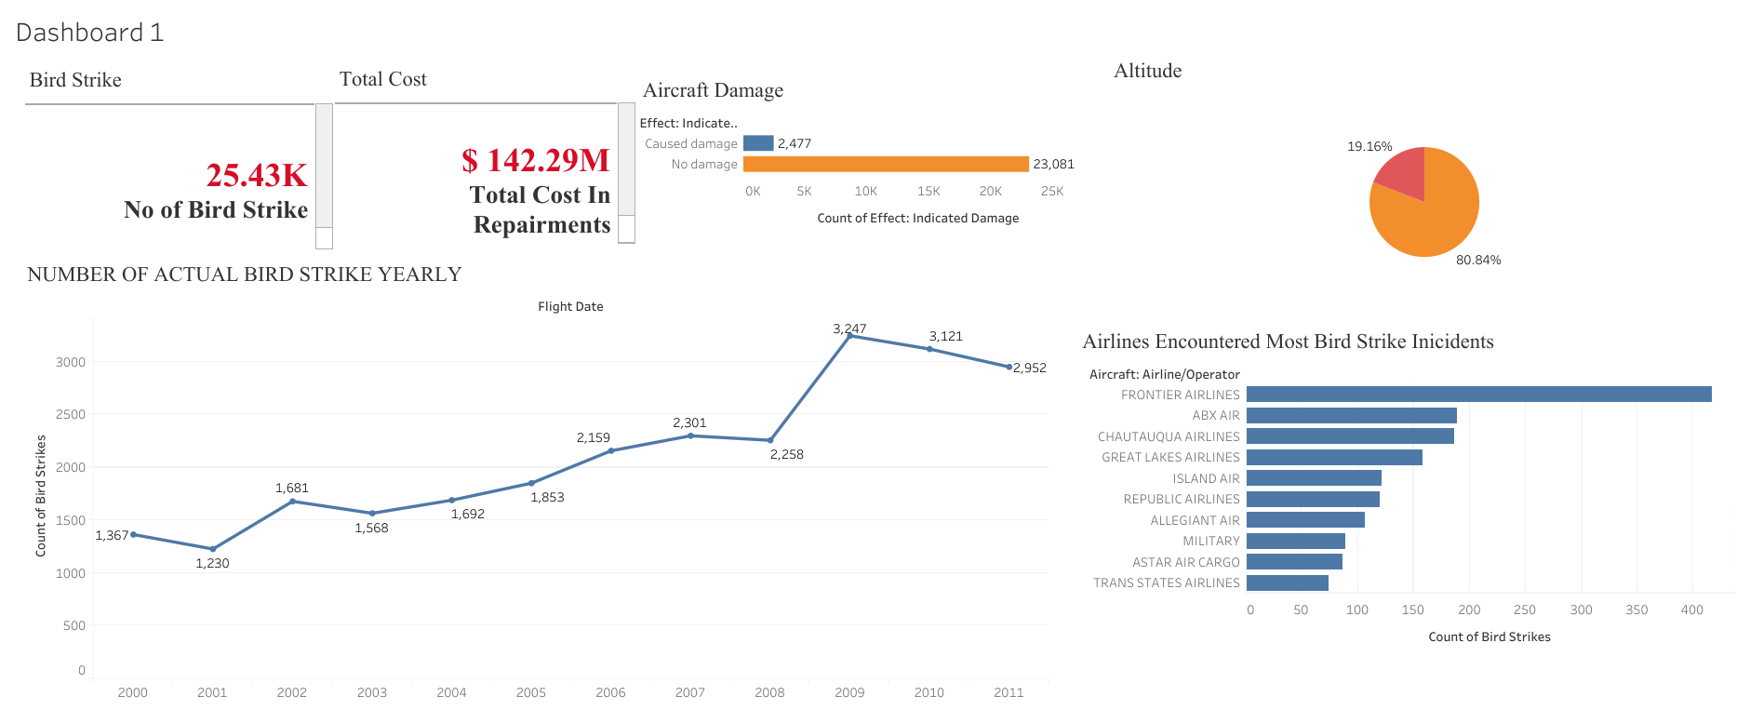

Slide 5
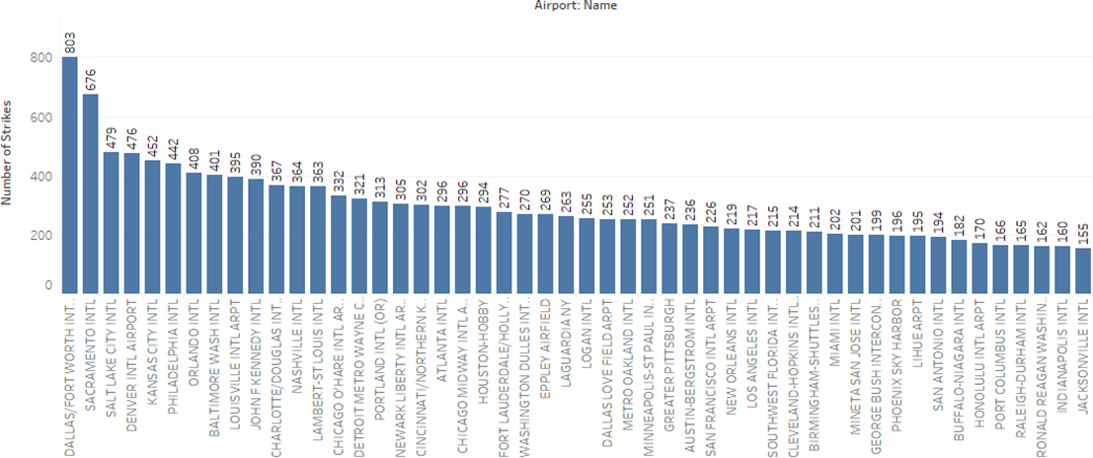
Airports with most incidents of bird strikes – Top 50
Most number of bird strike incidents had occurred at Dallas airport which is nearly 800 bird hits.
The second most dangerous airport for bird strike incident is Sacramento international followed by Salt lake city international with 676 and 479 incidents respectively.

Slide 6
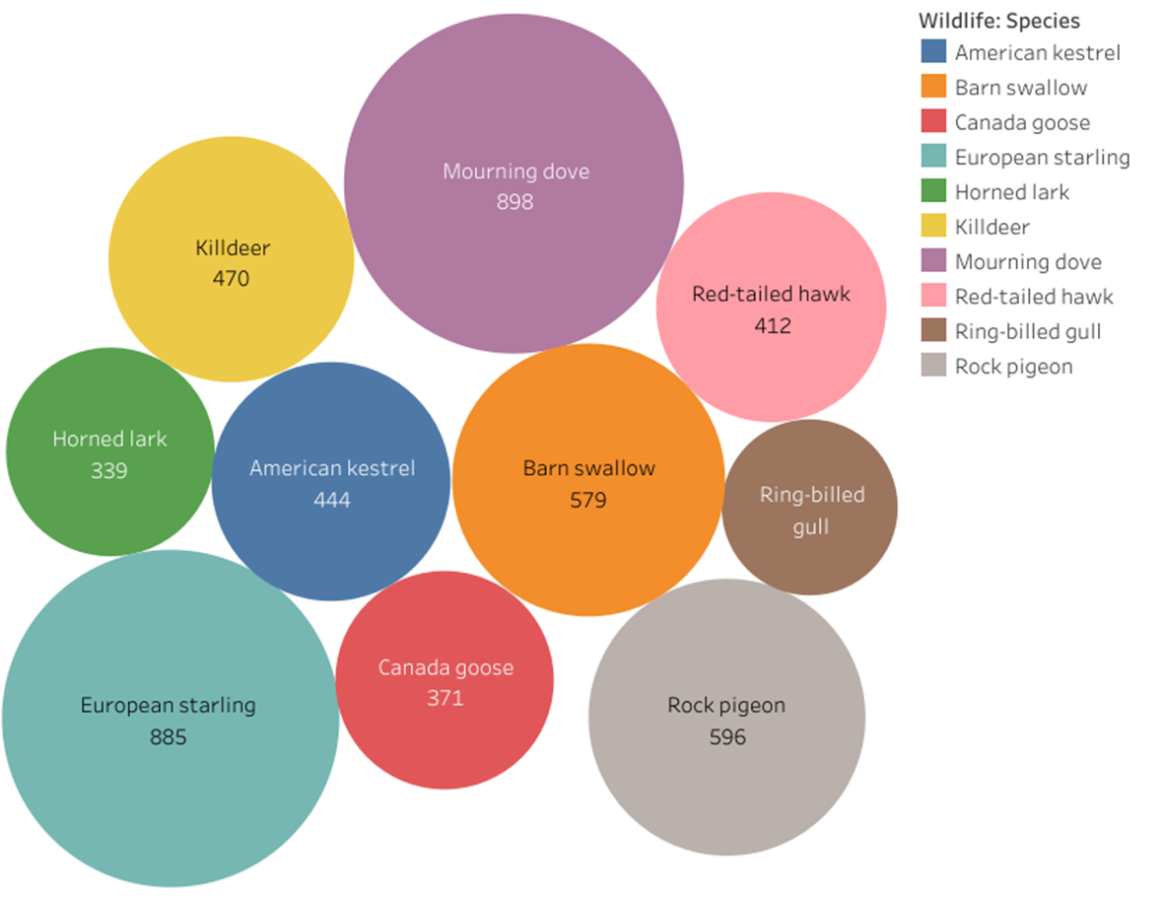
Top 10 Bird Species affecting Bird Strike
From the above bubble graph it is observed that the bird species which had been most struck by airplane is Mourning dove, European starling and Rock pigeon with 898, 885 and 596 hits respectively.

Slide 7
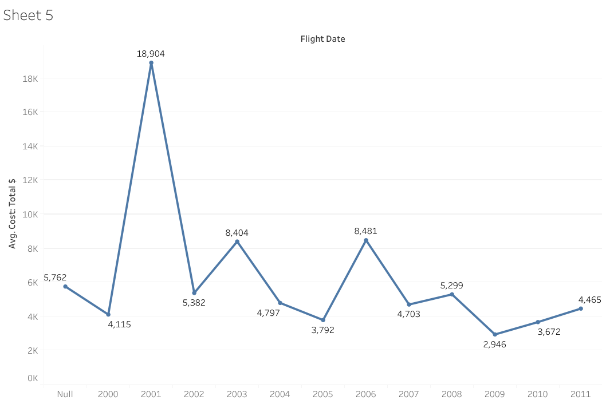
Average Cost Incurred due to Bird Strikes
The line chart represents the average amount of money used in order to repair the airplane which had been struck by birds.
The average cost of repairing was highest in 2001 which was nearly $ 19K.
In 2009, the average cost of repairing was lowest which was nearly $ 3K

Slide 8
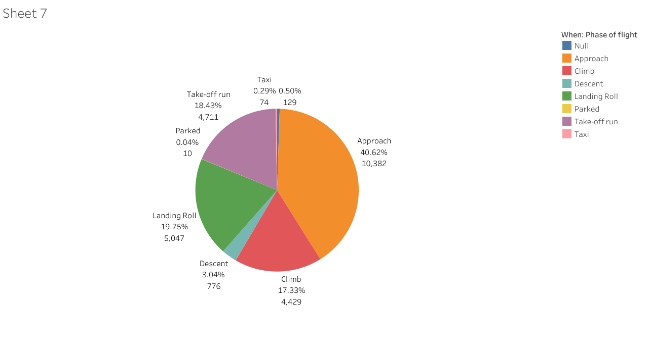
Phase of flight at the time of strike
From the pie chart it is observed that most of the bird strike occurs during the approach followed by landing roll.
40% of bird hits happens during approach while the chance of bird strike is least when airplane is parked or its taxiing.

Slide 9
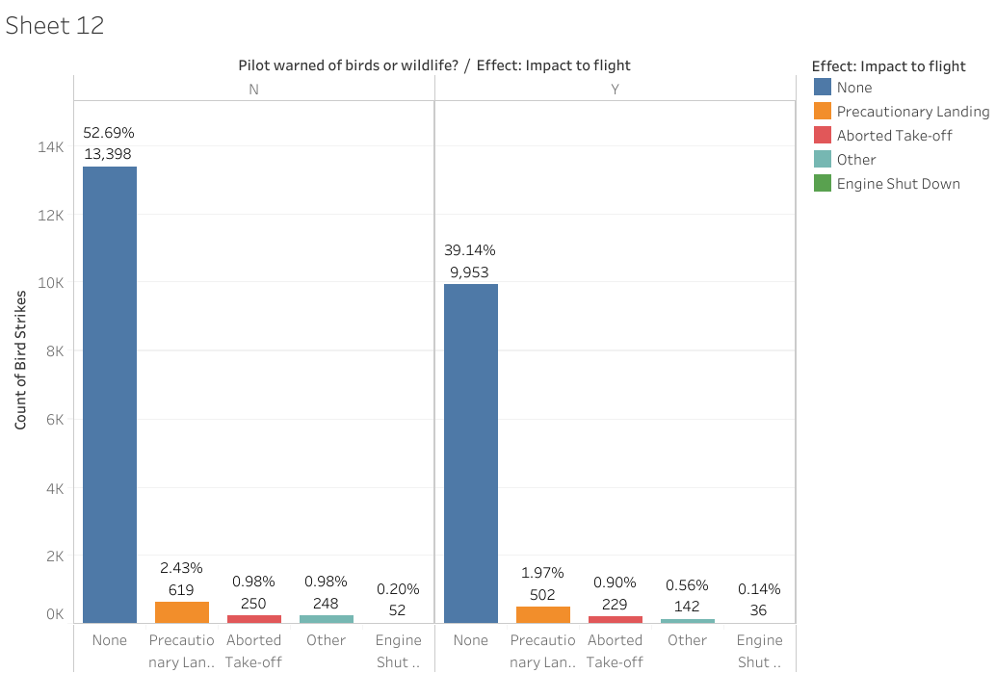
Prior Warning and Effect of Strike Relation
It is observed that in 52% total cases when pilot was not prior informed about bird strike, their was no damage while their was nearly 0.2 % cases of engine shutdown due to hit.
In case when pilot was prior informed about chance of bird strike, their was no damage in 39% of cases while their was 0.14% cases of engine shutdown.

Slide 10
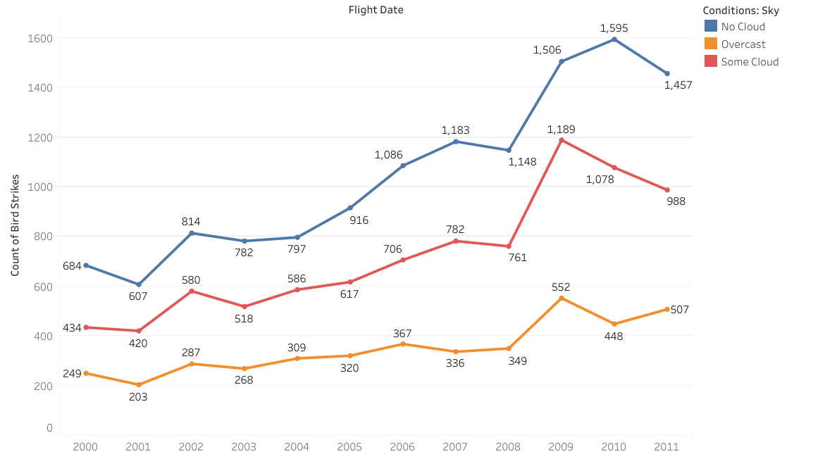
Worst Hit Conditions of Bird Strikes(Yearly)
From the line chart it is observed that majority of bird strike occurs when the sky is clear while there is least chance of bird strike when there is overcast.

Slide 11
THANK YOU

